Slide 1
RIGHTS-QUEST FIRST MINI-PROJECT REVIEW
Presented By:
Albert Trovan Fernandez (SJC21CS018)
Arun S Thomas (SJC21CS034)
Christin Sunny (SJC21CS044)
Danny M. Paul (SJC21CS045)

Slide 2
Problem Statement
Statement: Development of gamified platform on Children's Rights to increase legal literacy and awareness among children in India.

Slide 3
Objective and Scope
Objective: Create an engaging, inclusive platform for children (8-16) to learn and advocate for their rights.
In designing a game to educate children about their child rights, several key areas of project work need consideration:
I) Age Appropriate Content
II) Educational Content Coverage
III) Comprehensive and Interactive Learning
IV) Storyline and characters
V) Visual and Audio Elements
VI) Accessibility and User Experience

Slide 4
Literature Review
1. Sakka, T., & Gouscos, D. 2023. "Children’s Rights Education via Game-based Activities: An Intervention in Kindergarten." Journal Proceedings, Volume 10, Page Numbers 1-24
2. Øygardslia, K., Weitze, C. L., & Shin, J. 2020. "The Educational Potential of Visual Novel Games: Principles for Design." Journal Proceedings, Volume 2, Page Numbers 1-10.
3. Hussein, M. H., Ow, S. H., Cheong, L. S., Thong, M.-K., & Ale Ebrahim, N. (2019). Effects of Digital Game-Based Learning on Elementary Science Learning: A Systematic Review. IEEE Access, 7, 62465-62478. doi: 10.1109/ACCESS.2019.2916324.

Slide 5
Requirement Analysis: Data Collection
Collection of data consists mainly on the below given factors:
I) Gender
II) Age
III) Name
These factors are utilized to make a perfectly-tailored experience for the user.
Data collected is stored locally in user data.

Slide 6
Requirement Analysis: Functional
Educational Content Integration: Integrate lessons on kindness, empathy, social responsibility, and manners into gameplay through quizzes, videos, and character dialogues.
Offline Activities: Include offline activities or mini games that players can enjoy without an internet connection, ensuring uninterrupted gameplay.
Parental Controls: Include features that allow parents or guardians to set limits on playtime, restrict in-app purchases, and monitor their child's progress and interactions within the game.

Slide 7
Requirement Analysis: Non-Functional
Decision-Making Scenarios: Present players with various situations requiring moral choices related to kindness and manners.
Progression System: Implement a scoring or reward system that incentivizes positive behavior and encourages players to strive for continuous improvement.
Helpline Contact: A helpline to childcare and protection service is provided to further promote child safety in case of any issues that may harm the child.

Slide 8
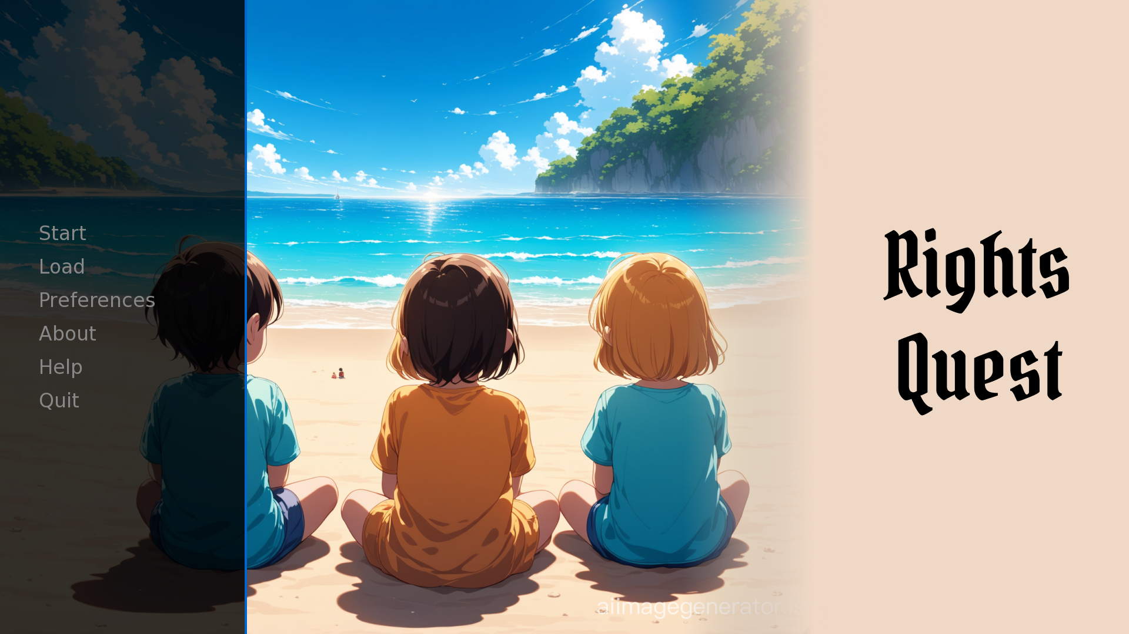
Design
Main Menu Screen:

Slide 9
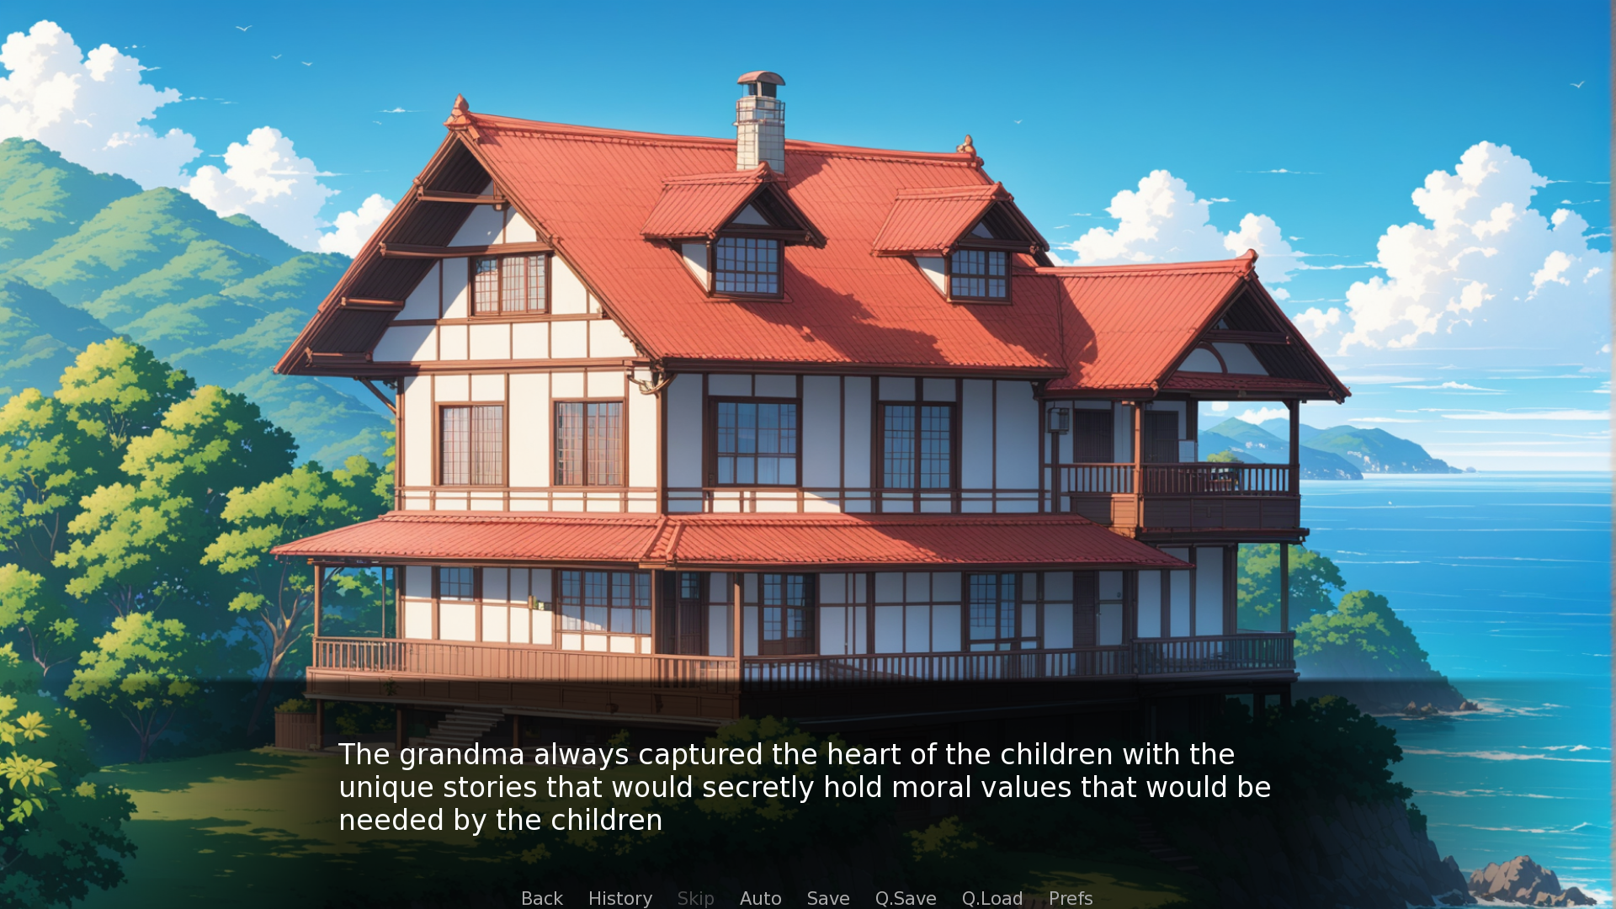
Design (Contd.)
In-Game Screen:

Slide 10
Module Description
Purpose: Revolutionize educational gaming by instilling a deep understanding of child rights.
Target Audience: Children (ages 4-12), educators, parents, and guardians.
Key Features:
Immersive storytelling and decision-making scenarios.
Various game modes and customization options.
Integration of educational content on kindness, empathy, and manners.

Slide 11
Module Description (Contd.)
4. Technical Specification: Offline functionality and hardware optimization.
5. Safety and Privacy: Clear guidelines and parental controls ensure a safe and engaging experience.
6. Outcome: Empowers children with knowledge about their rights in a fun and interactive way.

Slide 12
Technology Stack
Engines/Applications: RenPy, Unity, Adobe Photoshop CC, Adobe Premiere Pro CC, Adobe Audition CC/Audacity
Languages: Python, C#

Slide 13
Conclusion
In summary, "Rights-Quest" is an innovative educational game that empowers children with knowledge about their rights in a fun and engaging manner. Through immersive gameplay and captivating storytelling, it promotes awareness and understanding of child rights, fostering empathy and reflection among players.

Slide 14
References
Ren'Py Documentation: https://www.renpy.org/doc/html/index.html
Unity Documentation: https://docs.unity.com

